Slide 1
Plan Your Way OK Title Slide

Slide 2
Student Involvement in the IEP
Oklahoma State Department of Education

Slide 3
Attendee Outcomes:
Understand what active student involvement is AND why it is important
01
Understand how to actively involve students in their IEP
02
After attending & participating in this training, you will…
Make goals to increase student engagement in the planning processes
03

Slide 4
Module 1: What is Student Involvement in the IEP?

Slide 5
🤔Think About It
What does student involvement in the IEP look like, sound like, and/or feel like in your setting (classroom, school, or district)?

Slide 6
What does the Federal Law say?
PL 94-142- “…when appropriate”
IDEA- “require” starting at minimum age of 16 (most states follow this)

Slide 7
What does Oklahoma say?
Transition must begin prior to the student’s ninth grade year or earlier if deemed appropriate by the team
This means that the transition plan must first be developed during the student’s 8th grade year
At this age, students MUST be invited to their IEP meetings annually
If the student doesn’t attend, the school must take measures to ensure their preferences and interests are considered

Slide 8
Attendance
Vs
Participation

Slide 9
Involvement
Vs
Leadership

Slide 10
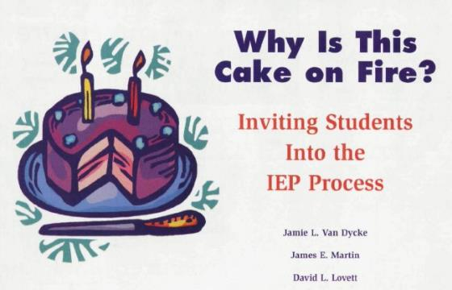
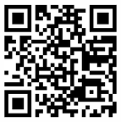
Must Read on Student Involvement in the IEP
https://tinyurl.com/Whyisthecakeonfire

Slide 11
Reflection Activity
Who currently speaks the most and least at your IEP meetings?
How is ‘student involvement’ factoring into who is speaking?
ASK and ANSWER the questions from the middle column labeled “Questions We Should Ask” on page 43 of the article you just read.

Slide 12
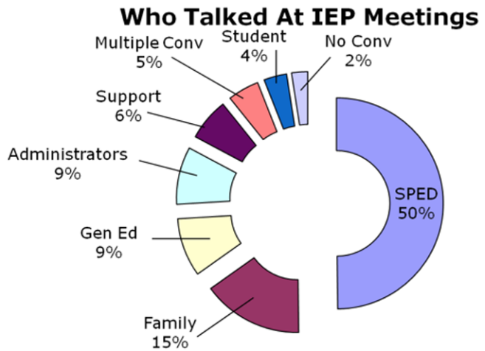
How does this visual align with your experience of who talks at teacher-led IEP meetings?

Slide 13
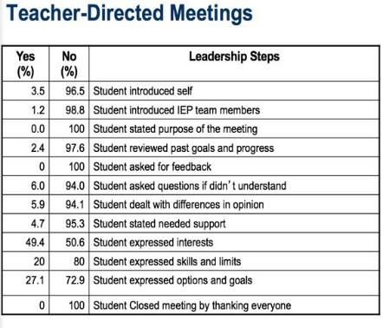
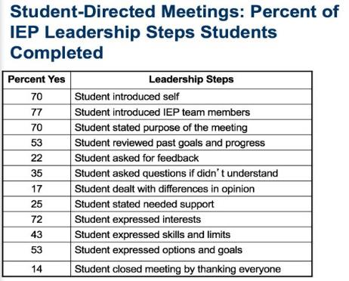
Let’s Compare Meeting Types

Slide 14
Garrett Takes Charge
Garret Takes Charge Video

Slide 15
What does Best Practice say?

Slide 16
Best Practice Recommendations for Transition Assessments
Prince et al., 2014
Use a variety of transition assessments (2+)
Update transition assessments ANNUALLY
Use at least one FORMAL assessment
Reflect student's skills and interests
Tailored to student’s NEEDS
Include a series of practical goals

Slide 17
Formal Vs. Informal Assessments
Formal Assessments: Validated and reliable
Examples: TAGG, AIR, SDLMI
Informal Assessments: Still valuable, but not validated
Examples: KC Life Skills, student interviews
NOT: BuzzFeed quizzes (those are just for fun!)

Slide 18
“School teams should ensure that student participation is maximized, including structuring meetings in such a way that student attendance and participation is facilitated”
Prince et al., 2014, p. 46
Key Point: This requires intentional planning BEFORE the meeting.

Slide 19
Benefits of Student Involvement in the IEP

Slide 20
There is a strong positive correlation between student involvement in the IEP and academic achievement—students take ownership of their educational performance and planning.
Barnard-Brak & Lechtenberger, 2010

Slide 21
When students with disabilities are involved in their own IEPs they “tended to be more aware of their disability, its impact on their school performance, and their need for self-advocacy.”
Mason et al., 2002, p. 188

Slide 22
Student involvement in the IEP provides the opportunity for students to learn and practice:
Important social skills
Self-advocacy
Public speaking
Self-evaluation
Mediation Skills
Goal setting and attainment
Martin et al., 2006; Torgensen et al., 2004

Slide 23
Benefits of elementary students' involvement in their IEP includes:
Danneker & Bottage, 2009
Meetings becoming more student-centered
Students have the opportunity to practice self-determination skills in authentic settings
Adults in the IEP meetings note increased efforts to solve problems collaboratively.

Slide 24

Module 1 Complete Next Step: Complete Module 1 Quiz

